Slide 1


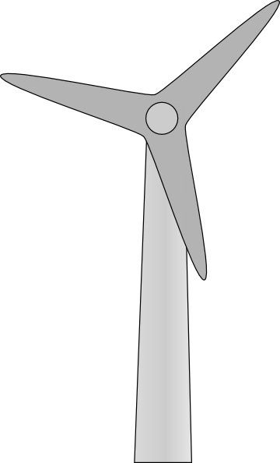
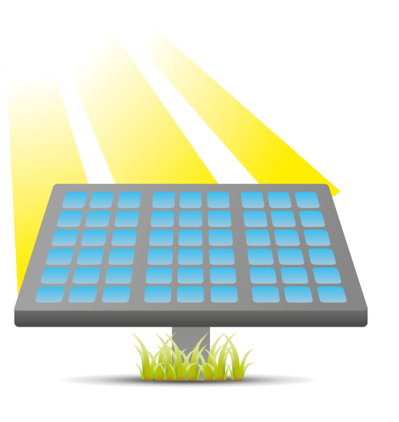
Introduction to Sustainable Electrical Energy:
Lab Notebook
Olivia Koehler
Spring 2016 (8 wk.)
EECT 175 –S1C

Slide 2
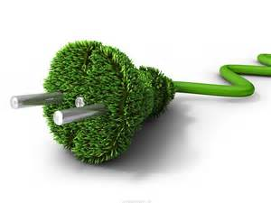
Table of Content
Lab 1: Storage Box Recharger Pg. 3
Lab 2: Collecting Solar Energy Pg. 14
Lab 3: Using the Wind Turbine Pg. 29
Lab 4: Battery Charging Pg. 39
Lab 5: Stored Energy/Discharging the batteries Pg. 48

Slide 3
Lab 1: Storage Box Recharger
3/23/16

Slide 4
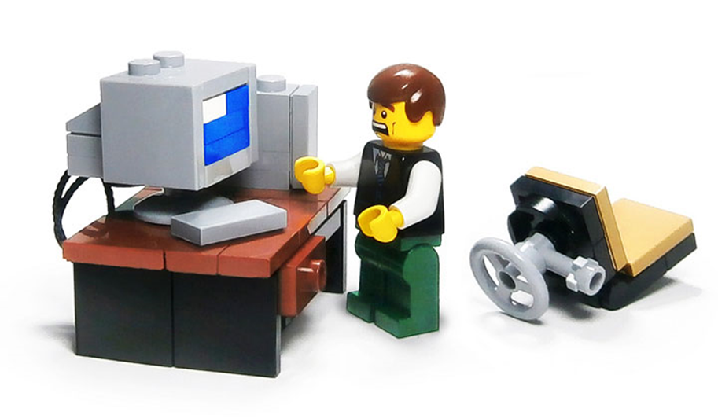
Purpose
To learn how to design a Lego Mind Storm program using the designated programming tool; the program will need to be able to charge the energy meter.

Slide 5
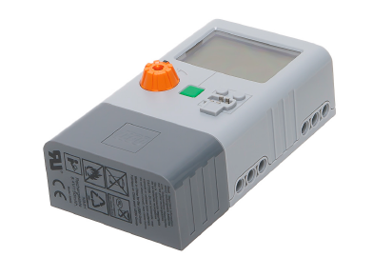
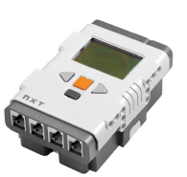
Parts List
(1) Energy Meter
(1) LEGO® MINDSTORMS® NXT

Slide 6

Hypothesis
Everything should work according to the manual, if all steps are followed properly no errors should be made.
If only it wasn’t
in Spanish…

Slide 7
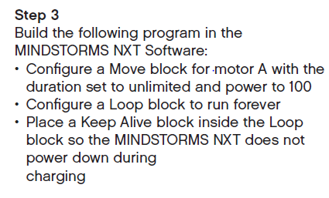
Research Notes
Following “Step 3” of the Renewable Energy Manual (Pg. 9) the program can be created. This is done using the MINDSTORMS NXT Software.

Slide 8

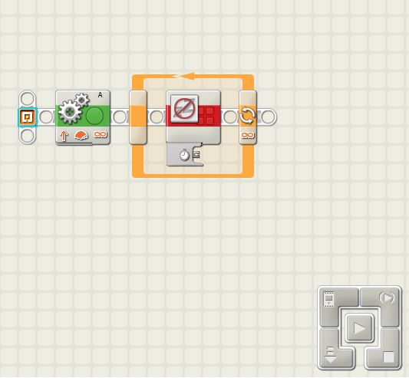
Schematic

Slide 9
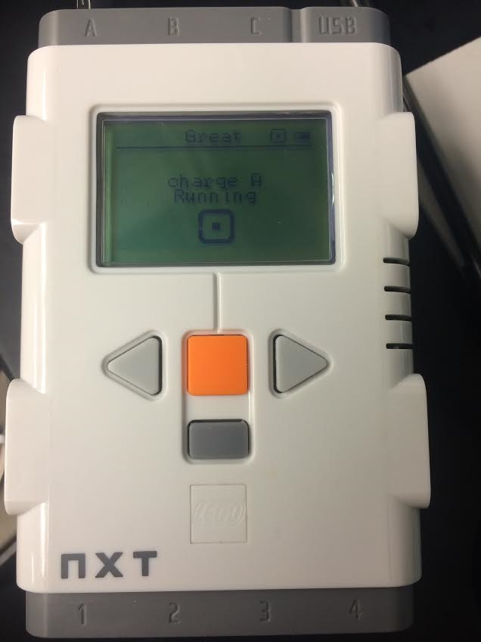
Experiment
The program created using the MINDSTORMS NXT software was transferred to the LEGO® MINDSTORMS® NXT without any issues.

Slide 10
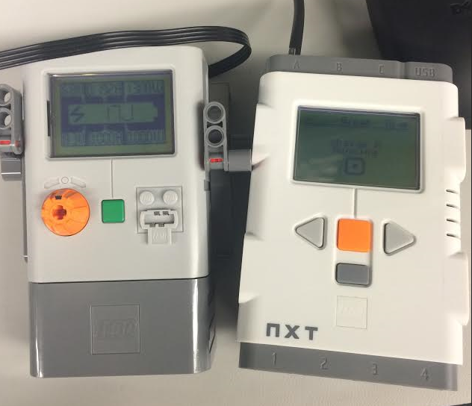
Experiment
After connecting the LEGO® MINDSTORMS® NXT to the energy meter, the battery quickly began to charge. It did not take long for it to display 100J.
**Note: Although 100J is not the max capacity the battery will hold, it is the max value that the meter will display on screen.

Slide 11
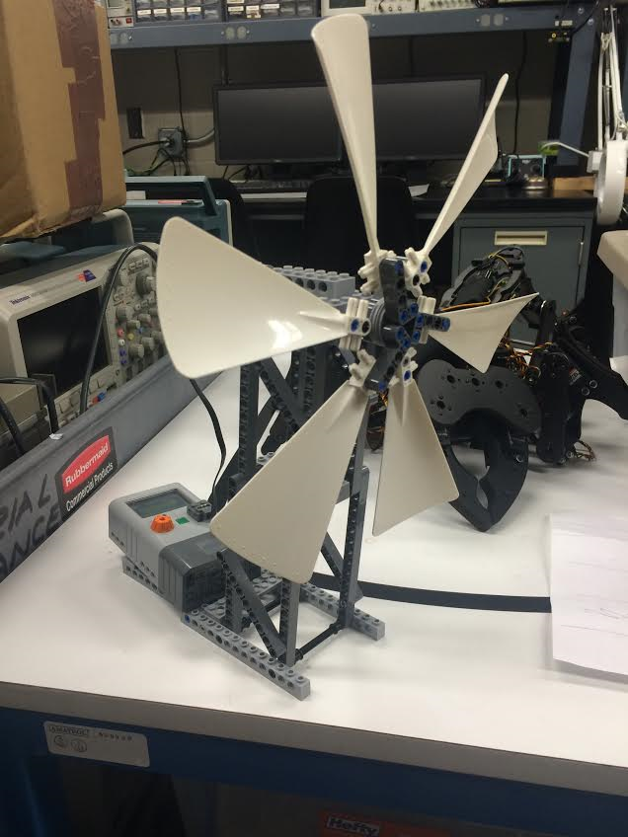
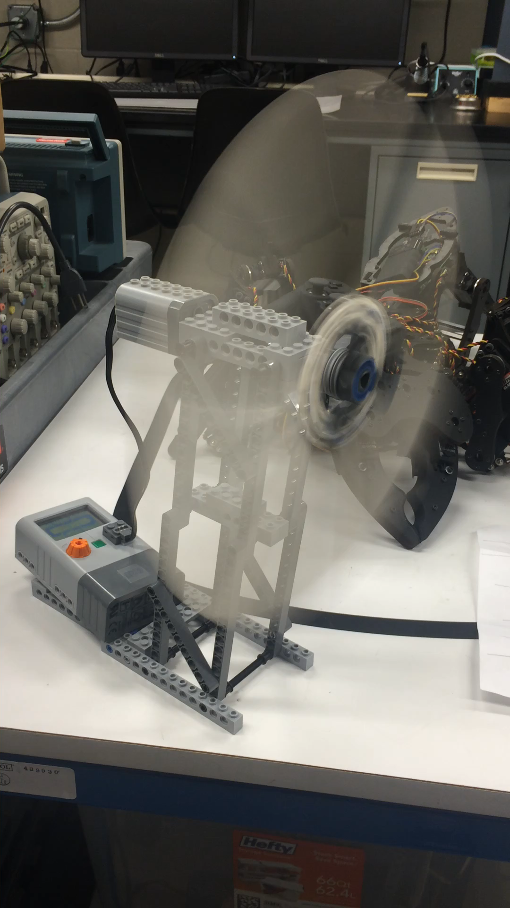
Experiment
The wind turbine was used to discharged the energy meter to ensure room for further experimentation.

Slide 12
Conclusion
Everything worked without issue, the programming directions were straight forward.
Because of this lab I now know how to program using the LEGO MINDSTORMS NXT Software, and will be able to apply this knowledge to future experiments.

Slide 13
Resources
https://online.ivytech.edu/bbcswebdav/pid-33491191-dt-content-rid-76377175_1/courses/EECT175-S1C-C1-201530/dw_55.pdf (Renewable Energy Manual)

Slide 14
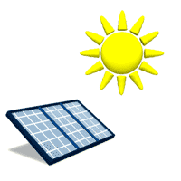
Lab 2: Collecting Solar Energy
3/30/16

Slide 15
Purpose
To understand how solar panels work in relationship to amount of light delivered to amount of wattage output.
To discover how long it will take to fully charge the energy storage box when certain requirements are met.

Slide 16
Parts List
(1) Energy Meter
(1) LEGO® MINDSTORMS® NXT
(1) Power Lamp
(1) Lego Solar Panel
(1) Multimeter (SN)

Slide 17
Hypothesis
The collection of energy should follow suit with the calculations done in excel.
The operation should not take too much time as long as the light is positioned correctly with the solar panel.

Slide 18
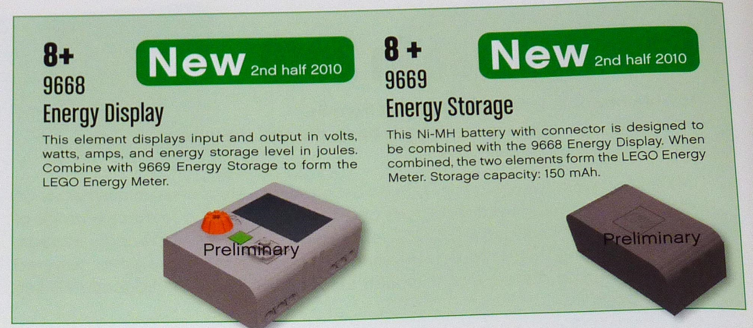
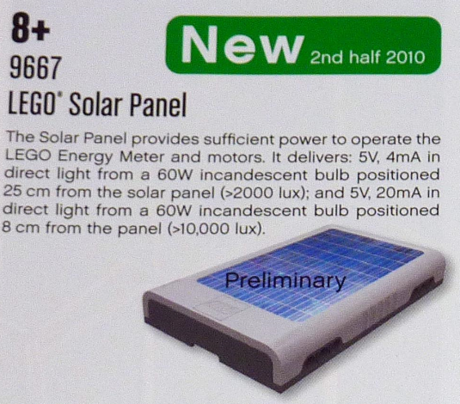
Research Notes

Slide 19
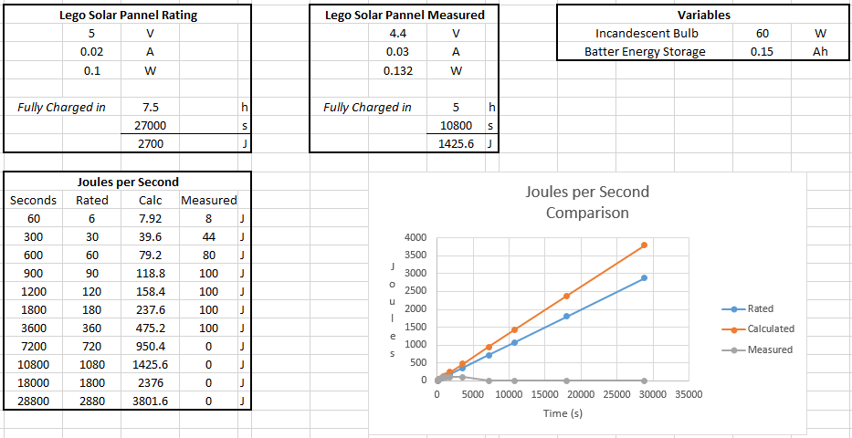
Calculations

Slide 20
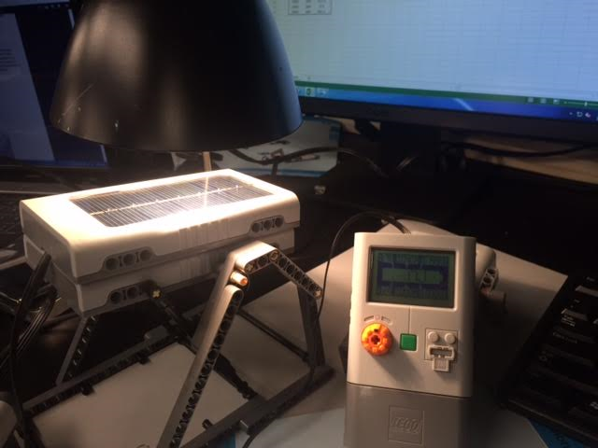
Experiment
The display would show incoming voltage, wattage and current that would correspond well with optimal settings. However no Joules would appear on the screen.

Slide 21
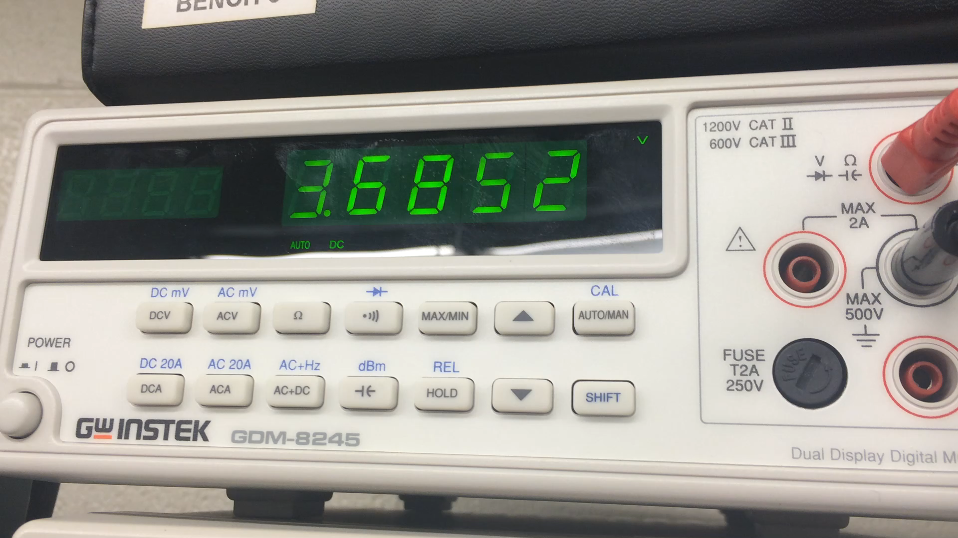
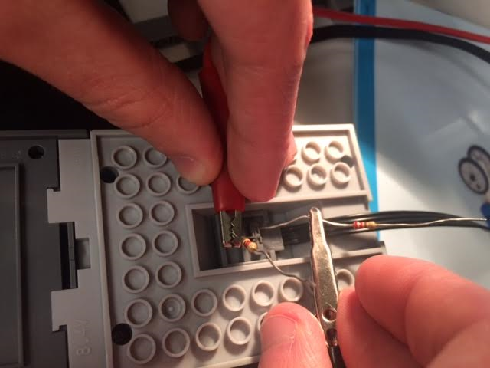
Experiment
The battery was tested to ensure it was indeed charging. The batteries voltage rating is 8.4 v, 7.4 v was measured. This showed the battery was charging, but where are the Joules?

Slide 22
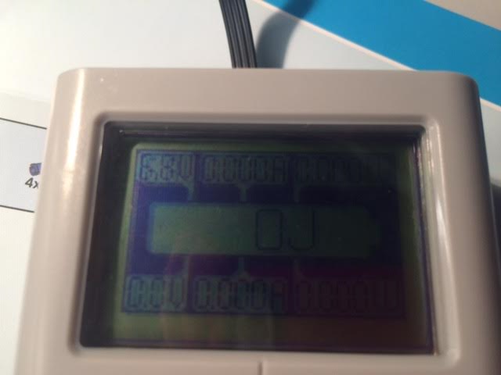
Experiment
A second Energy display and battery were used, just to make sure it had nothing to do with equipment error. The display showed near to the same results.

Slide 23
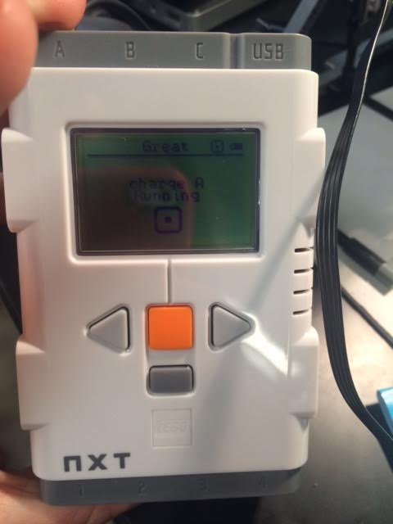
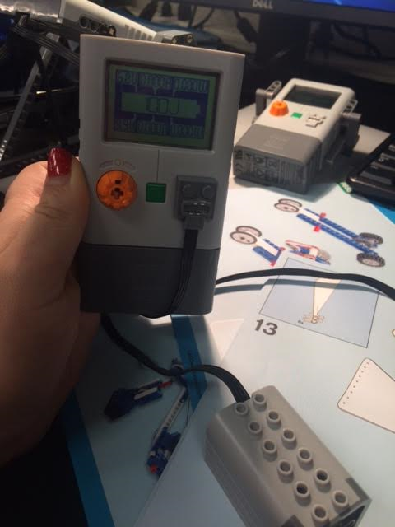
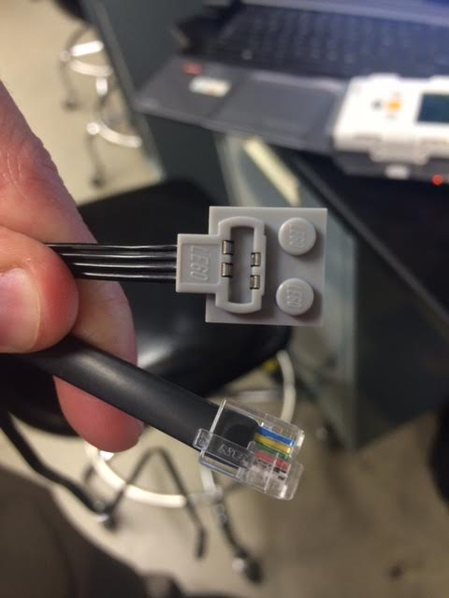
Experiment
Followed instructions to charge and discharge storage unit (Pg. 4 of Getting started with Lego Energy Meter Manual), then re-performed experiment.

Slide 24
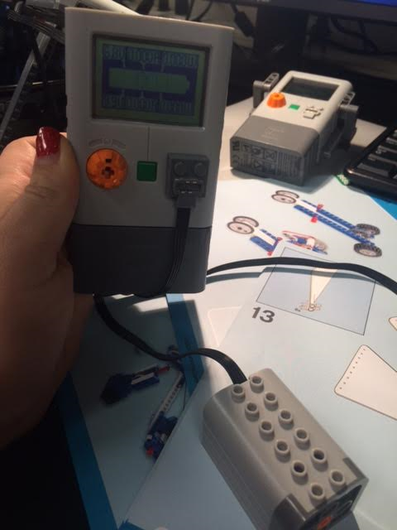
Experiment
Using a motor the Energy Meter was charged and discharged in three quick successions.

Slide 25
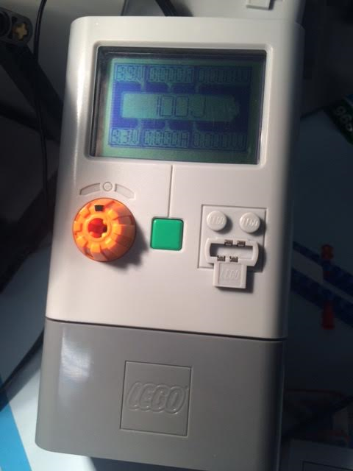
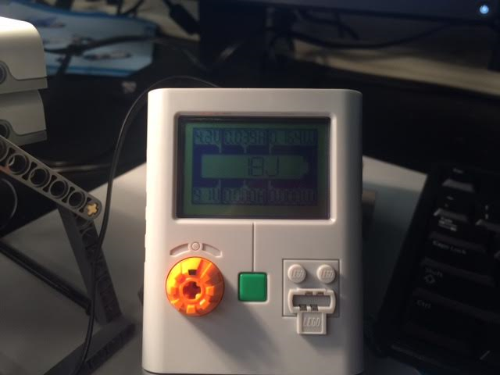
Experiment
Low and behold after the final discharging the energy meter was hooked up to the panel and received Joules galore!

Slide 26
Experiment
This time the Energy Meters display matched up to the calculations done previously.
Each Energy Meter used in the experiment was then automatically discharged.

Slide 27
Conclusion
Although there were some basic issues, the experiment ran well. The process followed fairly closely to the calculations done in excel.
I learned about Joules and the measurement of them before in my previous classes, however this experiment has taught me how to apply that knowledge to the everyday world.

Slide 28
Resources
https://online.ivytech.edu/bbcswebdav/pid-33491191-dt-content-rid-76377175_1/courses/EECT175-S1C-C1-201530/dw_55.pdf (Renewable Energy Manual)

Slide 29
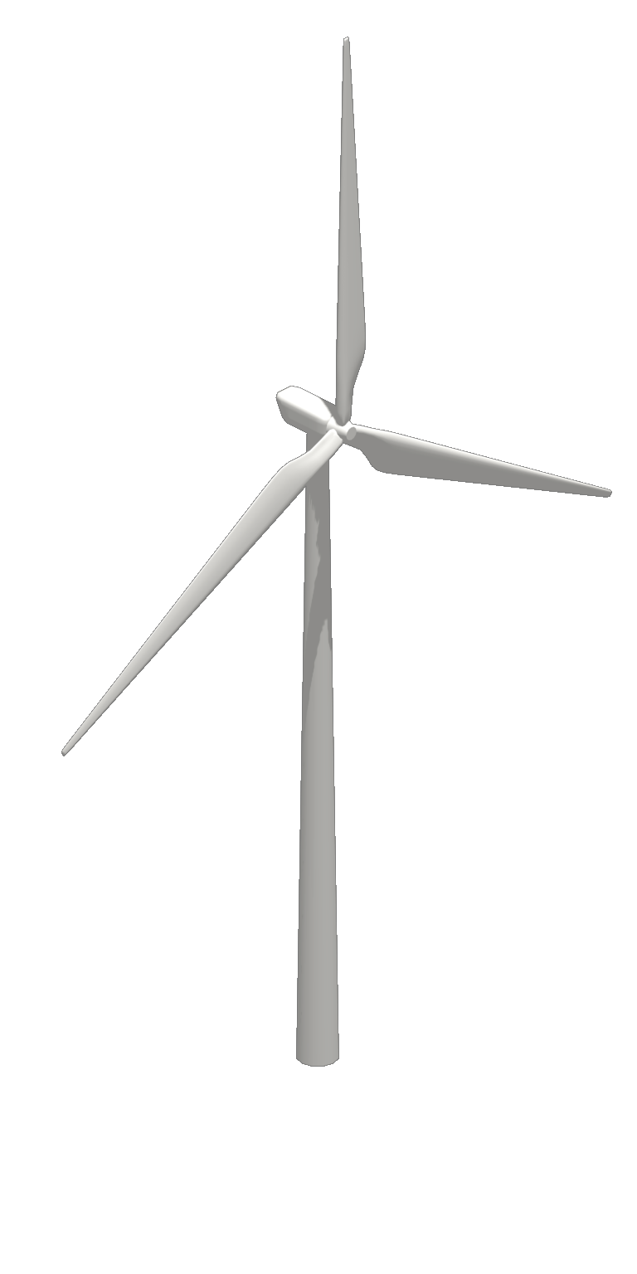
Lab 3: Using the Wind Turbine
4/6/16

Slide 30
Purpose
To work with and understand the interworking of wind turbines.
To discover how Joule collection can depend on many differing types of variables such as angle of wind and distance.

Slide 31

Parts List
(1) Energy Meter
(1) LEGO® MINDSTORMS® NXT
(1) NXT Wind Turbine
(1) Fan

Slide 32
Hypothesis
There are a lot of dependents involved when it comes to collecting wind energy. For example; how hard is the wind blowing, what angle is it coming from, the size of the blades…etc.
I believe with the particular model which was used, that the closer the turbine is to the fan, and the higher the fan is set, will produce the most amount of joules in the shortest time.

Slide 33
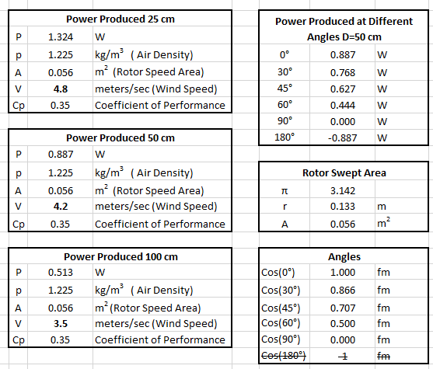
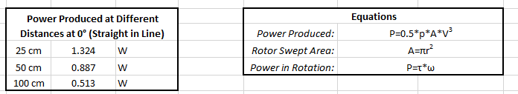
Calculations

Slide 34
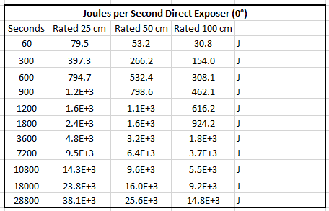
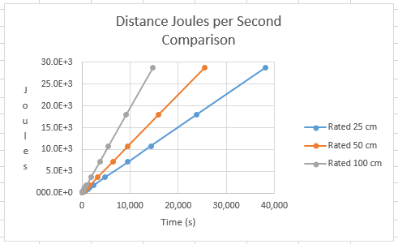
Calculations

Slide 35
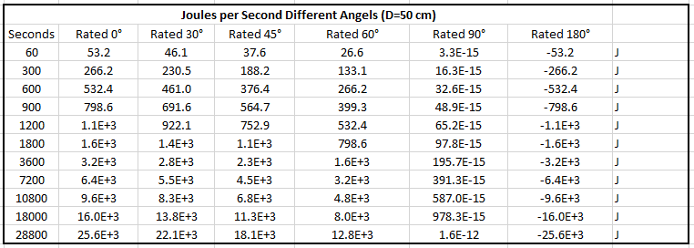
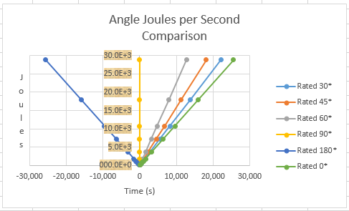
Calculations

Slide 36
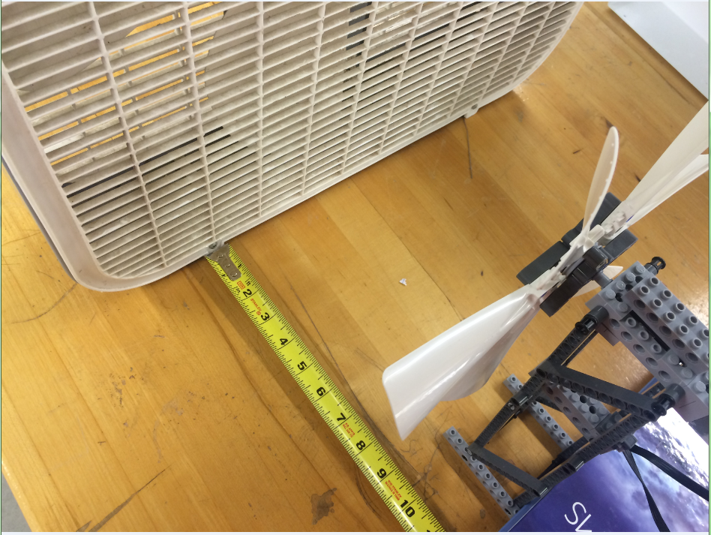
Experiment
Measurements were taken having the fan placed at different distances.
Those distances being: 25 cm, 50 cm and 100 cm

Slide 37
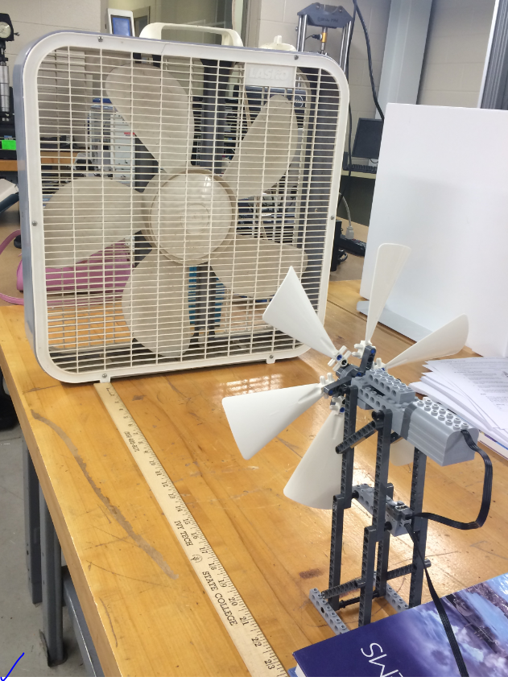
Experiment
Because the fan was not in the best of shape, only the maximum setting was usable on the fan.
However, even with this issue the experiment still supplied good results.

Slide 38
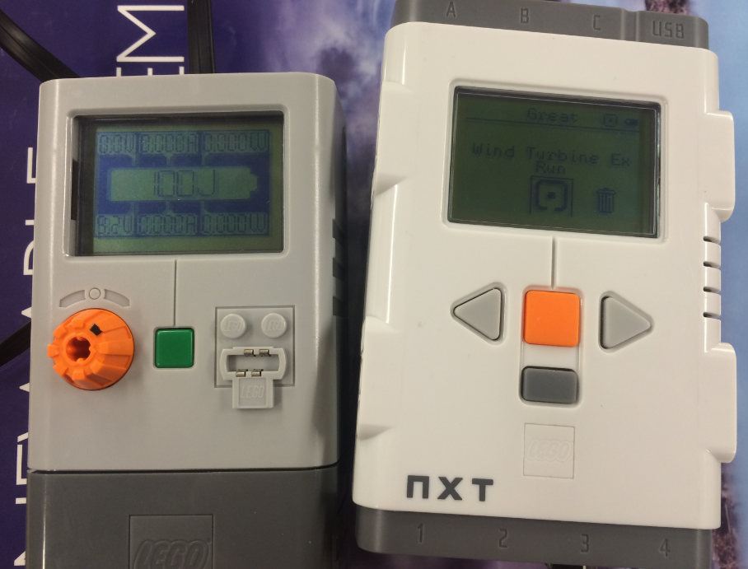
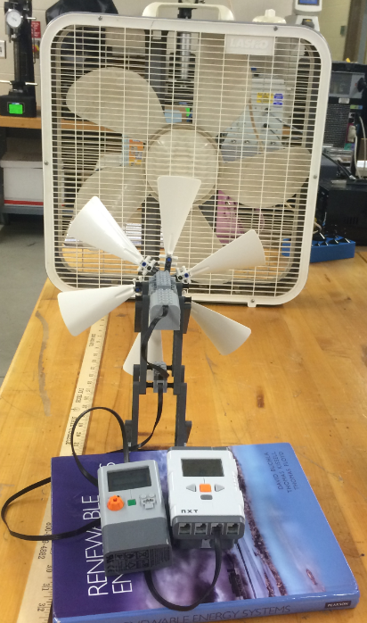
Experiment
Although the duration of each experiment changed with the distance of the turbine from the wind source, each distance still was able to fully charge the energy meter.

Slide 39
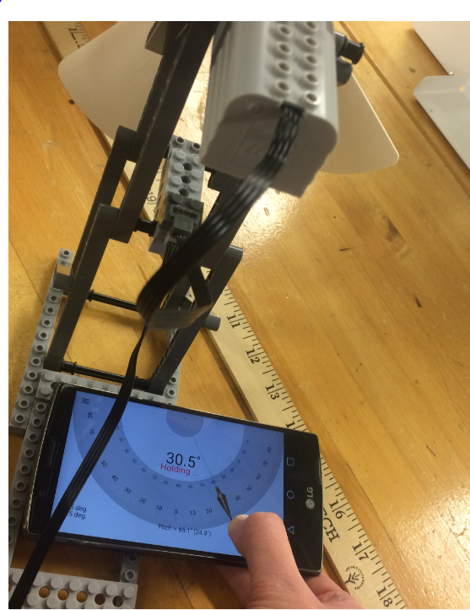
Experiment
Measurements were also taken with the fan placed at different angles.
However, no position yielded better results then the wind making contact with the turbine head on.

Slide 40
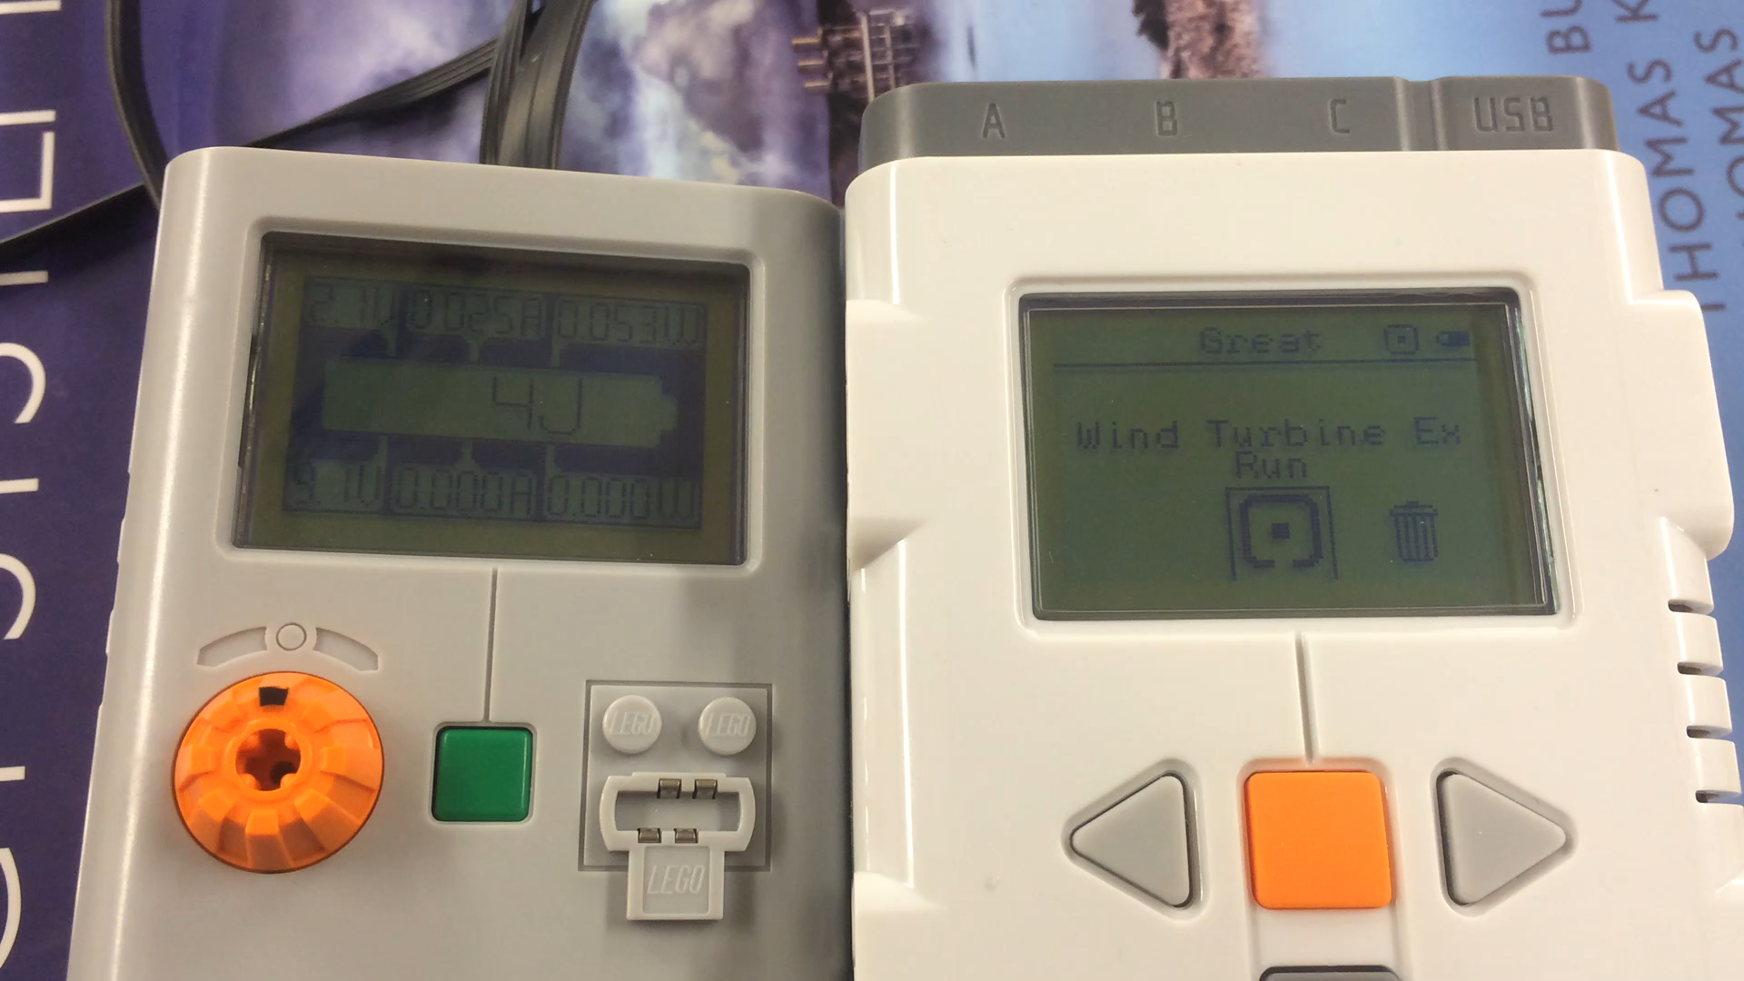
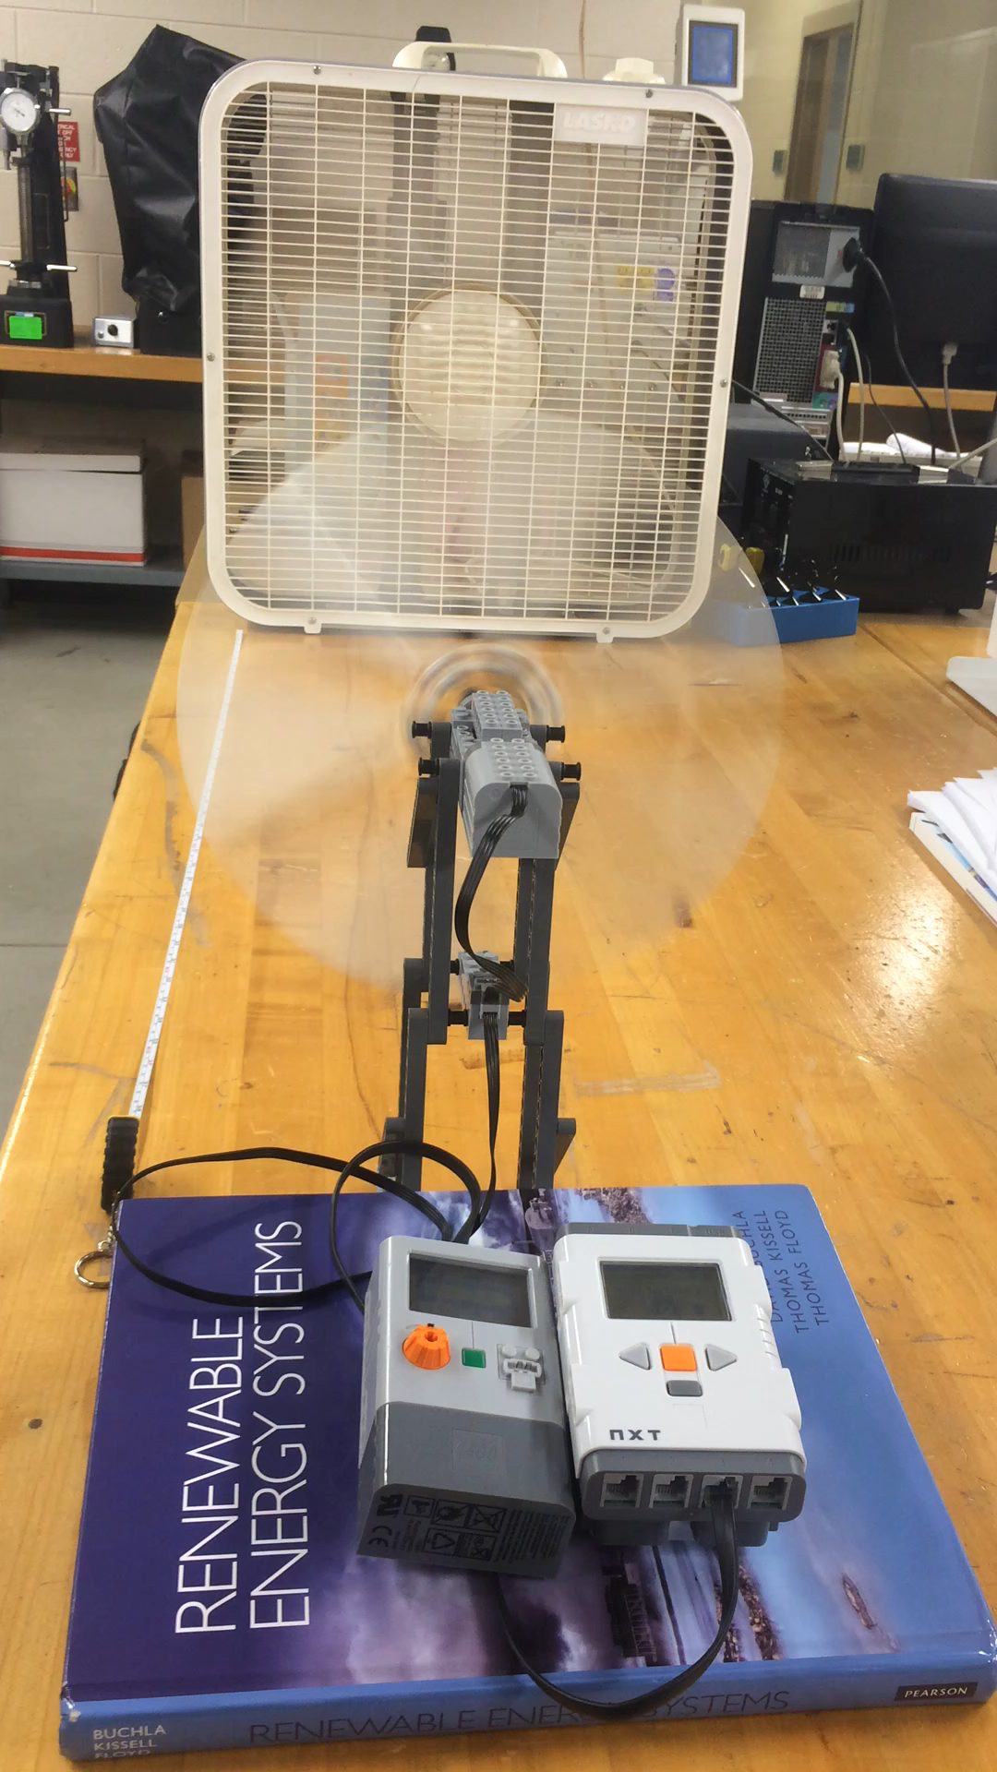
Experiment

Slide 41
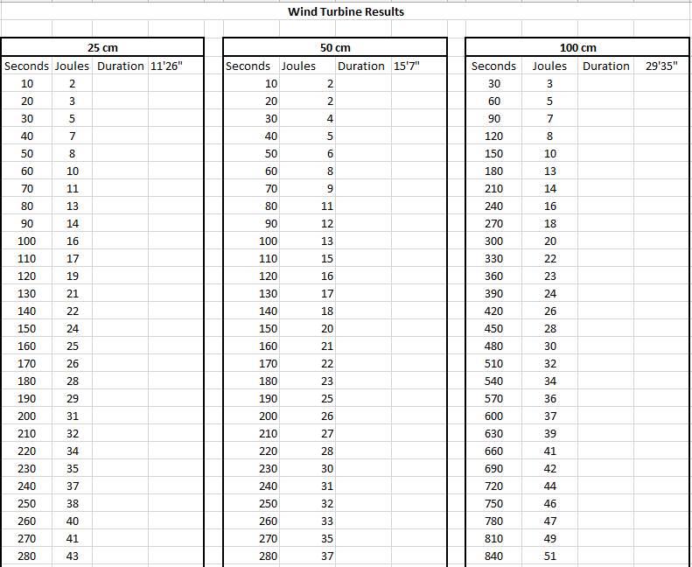
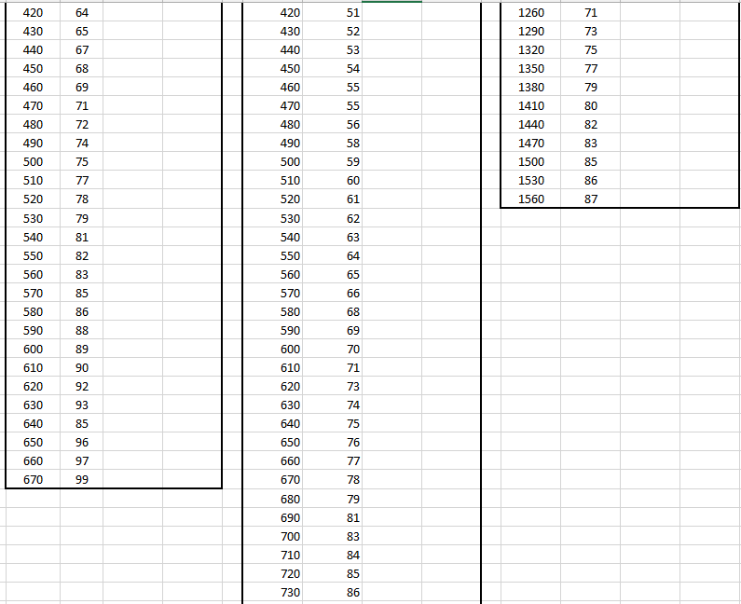
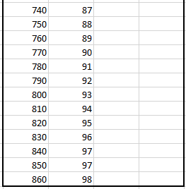
Experiment - Results

Slide 42
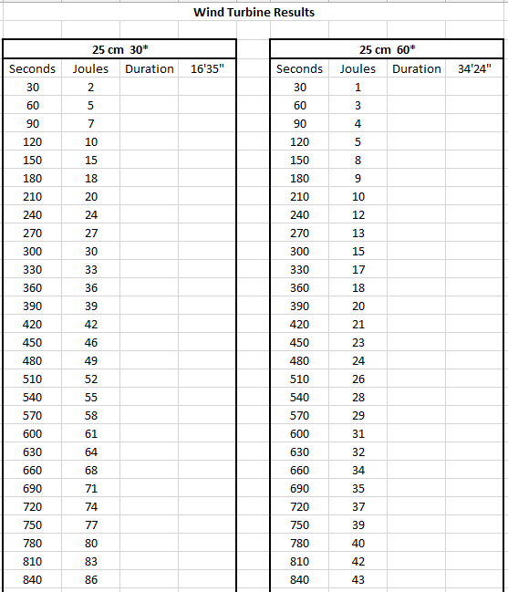
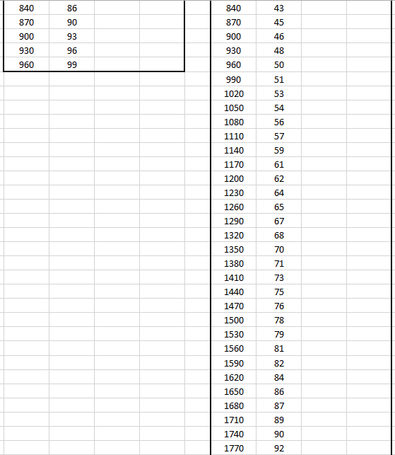
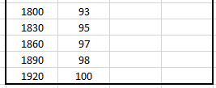
Experiment - Results

Slide 43
Conclusion
Experiments ran smoothly, there were no issues with the process besides the fans setting which could only be used at the highest setting.
Wind energy is a good source of energy, because depending on the direction of the wind it can be collected swiftly and easily. If a tail is added to change the turbine to the direction of the wind, wind energy can easily be one of the best tools for collecting energy.

Slide 44
Resources
https://online.ivytech.edu/bbcswebdav/pid-33491191-dt-content-rid-76377175_1/courses/EECT175-S1C-C1-201530/dw_55.pdf (Renewable Energy Manual)
http://www.hudsonproducts.com/products/tuflite/flowfans.pdf (Basics of AXIAL FLOW FANS)
http://learn.kidwind.org/learn/science_fair_projects (Equations)
http://learn.kidwind.org/sites/default/files/swept_area2.pdf (More Equations)
http://kwind.me/assets/challenge/WINDSPEED.pdf (Turbine Performance Calculations)

Slide 45
Lab 4: Battery Charging
4/13/16

Slide 46
Purpose
Solar panels have the ability to supply electricity to our homes, during the day when the Sun is bright and we can quickly receive the energy. However, if a cloud casts a shadow or the sun begins to set, there will be no electricity to be received from the Sun. Because one may wish to receive electricity even during nightfall, batteries are used to store power which can be accessed at anytime.

Slide 47
Parts List
(4) Energizer AA4 Recharge Plus Batteries
(1) Solar 2 in 1 Folding Panel (ES908)
(1) LAMP BRAND NAME
(1) Multimeter (SN)

Slide 48
Hypothesis
The maximum stored current each individual battery can hold is 2300mAh.
In full sun the solar panel can deliver 150 mA of current
If the battery is dead, how long will it take to fully charge it with the solar panel?
2300mAh ÷ 150mA = 15 hours

Slide 49
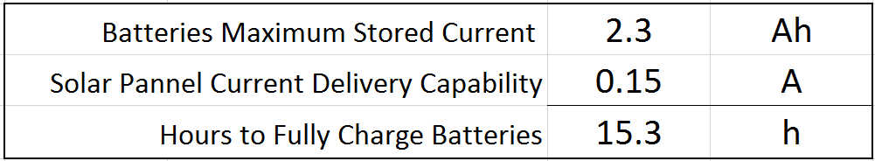
Calculations

Slide 50
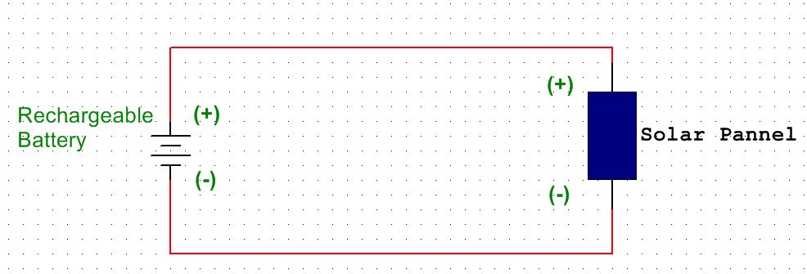
Schematic

Slide 51
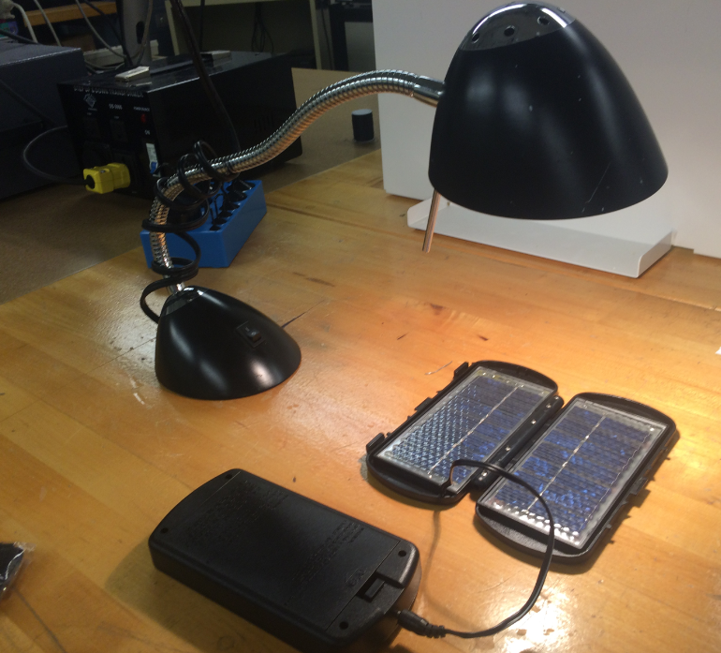
Experiment
Solar energy was collected using a dual solar panel. It took around 17 hours for the batteries to fully charge.

Slide 52
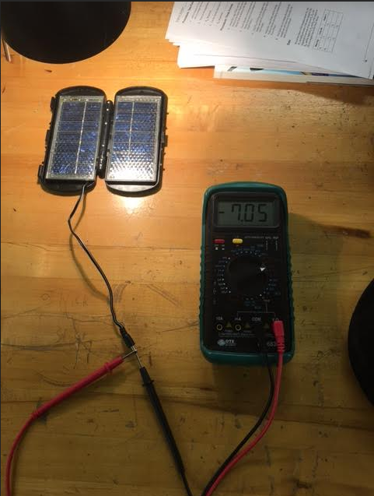

Experiment – Taking Measurements

Slide 53


Experiment – Taking Measurements
(After Charge)

Slide 54
Conclusion
The batteries took almost a day to fully charge with the aid of the solar panel.
The calculations in excel were true, when compared to the results.

Slide 55
Resources
http://data.energizer.com/PDFs/Rechargeable_FAQ.pdf (Energizer.com)
http://www.energizer.com/batteries/energizer-rechargeable-batteries (Energizer.com)

Slide 56
Lab 7: Stored Energy/Discharging the batteries
4/20/16

Slide 57
Purpose
Once the batteries are fully charged, they have stored energy within them. The purpose of this experiment is to find out how long this type of battery would last while supplying energy to an outside source, in this case 4 LEDs.

Slide 58
Parts List
(4) Energizer AA4 Recharge Plus Batteries
(1) Multimeter (SN)
(4) Red LED
(4) 100Ω Resistor
(1) Breadboard

Slide 59
Hypothesis
The rechargeable batteries:
Max stored current = 2300mAh
Max supply voltage = 3.4VThe LEDs:
V_{f} = MAX 2.5 V
I_{f} = 20mA
If the LEDs run until the battery is dead, how long will the LEDs run from a fully charged battery?
I ÷ C = T

Slide 60

Calculations

Slide 61

Schematic

Slide 62


Experiment
The current that was running from the batteries that were in series to the LEDs was measured.

Slide 63

Experiment
The batteries then were left to discharge. The amount of time calculated previously closely matched the results.

Slide 64
Conclusion
The experiment was a success, the batteries were able to discharge close to the same rate as the excel calculations predicted. It took about 4 hours to completely drain the four batteries in series.

Slide 65
Resources
http://www.instructables.com/answers/Does-and-LEDs-current-draw-depend-on-its-voltage-/ (Explanation on LED inner workings)
https://learn.adafruit.com/all-about-leds/the-led-datasheet (LED Datasheet)

